Slide 1
Sesam Training
3. juni 2021
Notes:
Velkommen
Info om pauser (prøve på 50 + 10)
Om spørsmål

Slide 2
Who are we ?
Notes:
Gab
Give some info about us:
- Norway, Oslo. Branching out across Europe.
- 40+ employees
- Product company first, consultancy second.
Introduce ourselves:
- Gab
- Erik
ask for intro from people
Ask about Sesam, they know what it is, (IPaaS (integration platform as a service), datahub) what does it mean?

Slide 3
Day One Overview
Integration Architecture
Importing Data and Concepts Cont.
Playing the long game
Merging data
9:00- 9:15
10:00 – 10:30
11:45 – 12:00
13:30 – 14:30
9:15 -09:50
10:40 -11:15
12:00 – 13:30
14:30 -16:00
Introduction to Sesam
UI Hands On and Sesam Concepts
Datasets
Joins and intersections
Notes:
G

Slide 4
Day Two Overview
DTL
Defining functions
Hands-on excersise
DTL
Data Transformation Language
Questions / Answers
Publishing Data
9:00- 9:50
11:35 – 12:30
13:00 – 14:00
14:40 – 15:30
10:00 -11:00
12:40 -13:45
14:00 – 14:30
15:30 -16:00
Recap of Day 1
Shaping Data
Hands-on Excersise
Using Hops
Hands-on Excersise
Microservices- How to?
Notes:
G

Slide 5
Key Take Aways
* Introduction to Integration with SESAM
* Get a basic understanding of how SESAM works
* Start using SESAM
* Experience connecting data in SESAM and use DTL
* The Sesam way – data-driven mindset
Notes:
G

Slide 6

Integration Architectures
Point to point
Enterprise service bus (ESB)
Data driven
Notes:
Not very detailed
A historic perspective on data integrations architectures
Many differences within each integration architecture type
General strokes

Slide 7
Integration Architectures
Point to point
Enterprise service bus (ESB)
Data driven

Slide 8
Point to point
Very first type of integration
Quick to set up
Cheap short-term
High amount of control for devs
Low reusability
Synchronous
Notes:
Intuitive start

Slide 9

Point to point

Slide 10
Integration Architectures
Point to point
Enterprise service bus (ESB)
Data driven

Slide 11
Integration Architectures
Point to point
Enterprise service bus (ESB)
Data driven

Slide 12
Enterprise service bus
Asynchronous
Message/Queue based
Built for scale
Centralized maintenance
In practice - point to point
Complex data structures
Data in source systems/silos
Notes:
An ESB is bus based integration providing a central place for the services, applications, and IT resources in general that you want to connect.”
ESB architecture is usually stateless; state is attached to the message
Canonical message format; typically XML, often standards-based
The message is the contract between systems
Each integrated system has an adapter to translate from the application format to the canonical format

Slide 13
Enterprise service bus

Slide 14
Integration Architectures
Point to point
Enterprise service bus (ESB)
Data driven

Slide 15
Integration Architectures
Point to point
Enterprise service bus (ESB)
Data driven

Slide 16
Data driven
Asynchronous
Centralized data hub
Data readily available for new integrations
System independent
Schema-less
Multi-master

Slide 17
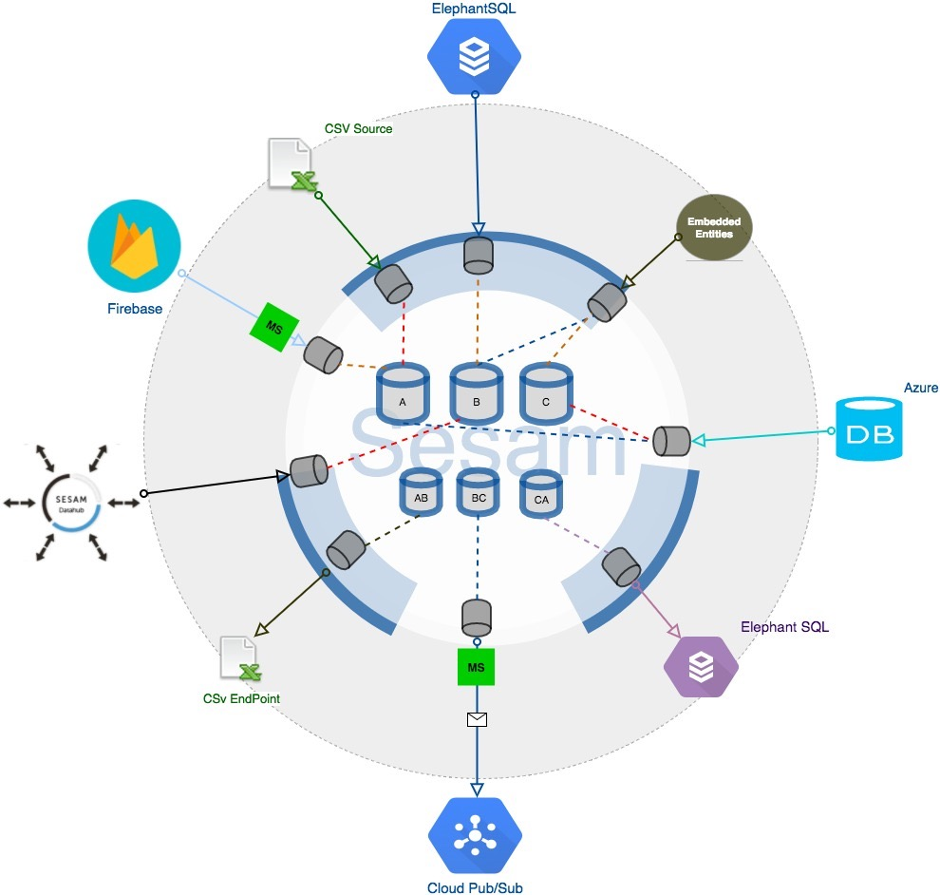
Sesam data Model
Collect, connect and share
Powerful modularity
JSON internally
Built in Connectors / Interfaces
Microservices
Collect to abstract away data sources
First priority is the Data
Connect to enhance & Simplify
Prioritize the most truthful data across sources
Aggregate object information
Share according to external requirements
Multiple interfaces, schedules, full/incremental
Data-oriented mindset.
What data is needed where and when?
How to use the data instead of how to get it.
Notes:
Internally Sesam utilizes a JSON dictionary data structure
allows us to treat all data the same way independent of source system.
DTL specifically created to handle data transformations
Collect abstract data
Stop thinking about where the data originates and rather what type of data it is
Organize the data semantically for a more efficient, effective and intuitive managed platform.
Clothes
Much like organizing your tools. You don’t put painting equipment with your bit sets, even though they are bought at the same store. In order to quickly start a new project at home you need to

Slide 18

Coffee Break
10’ pause

Slide 19



Sesam Concepts
Systems
Data source
Data sink
Pipes
Datasets
Entities

Slide 20

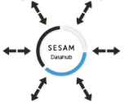

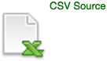


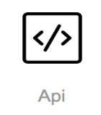



Systems
They represent the external endpoints from which we get, receive or send data.
Have name and configuration
example: A database
Single place to put connection strings and authentication settings
Some of the most common systems:
Notes:
S | G?
Note
Talk about the sesam ecosystem?
We have included some basic connectors, but there are a lot more open source on out github.
Feel free to use and hopefully add to them.

Slide 21

Environment variables and secrets
Environment variables
Environment variables can be used everywhere in Sesam where you can write config
In config you can use the environment variable with "$ENV(my-variable)"
Secrets
Similar to environment variables but can only be used in System config.
Used in config with "$SECRET(my-secret)"
Sesam provides a ‘secrets service’​ where you can add and remove secrets in the portal
Secrets are never logged and they are never unencrypted at rest. ​
Notes:
S | G?
Vars: Like globally defined variables
Useble everywhere in sesam where you can write config.
Changeble, readble
Secrets: secret service, saved and not logged.
Not unencrypted at rest.
Not usable outside of systems
Now editable but not readable

Slide 22

System config
{
"_id": "crm",
"type": "system:mssql-azure-dw",
"database": "sesam_training",
"host": "sesam.database.windows.net",
"password": "easy",
"username": "me"
}
{
"_id": "crm",
"type": "system:mssql-azure-dw",
"database": "sesam_training",
"host": "sesam.database.windows.net",
"password": "$SECRET(crm-password)",
"username": "$ENV(crm-user)"
}
Host/url
Username
Password/key
Notes:
S | G?

Slide 23
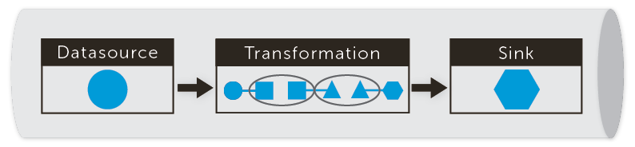
Pipes
There is only one type of moving part in Sesam: The PIPE
Single, simple abstraction for the movement of data.
Power of pipes is that they can be composed, and data flows along them
Data flows from source system into Sesam, for transformation inside Sesam, and out to target systems. The pipe is the unifying concept.
Notes:
D

Slide 24
Structure of a Pipe
{
"_id": "crm-person"
"type": "pipe",
"source": {
"type": "sql",
"table": "person"
},
"sink": {
"type": "dataset",
"dataset": "crm-person"
},
"transform": {
"type": "dtl",
"rules": {
"default": [
["copy", "_id"]
]
}
},
"pump": {
"schedule_interval": 30
}
}
Identity of the pipe
Source System (dataset , system)
Target/ Sink (dataset or system)
Actual Transformation Rules
Scheduling (custom / cron)
Notes:
D
5 minutes

Slide 25
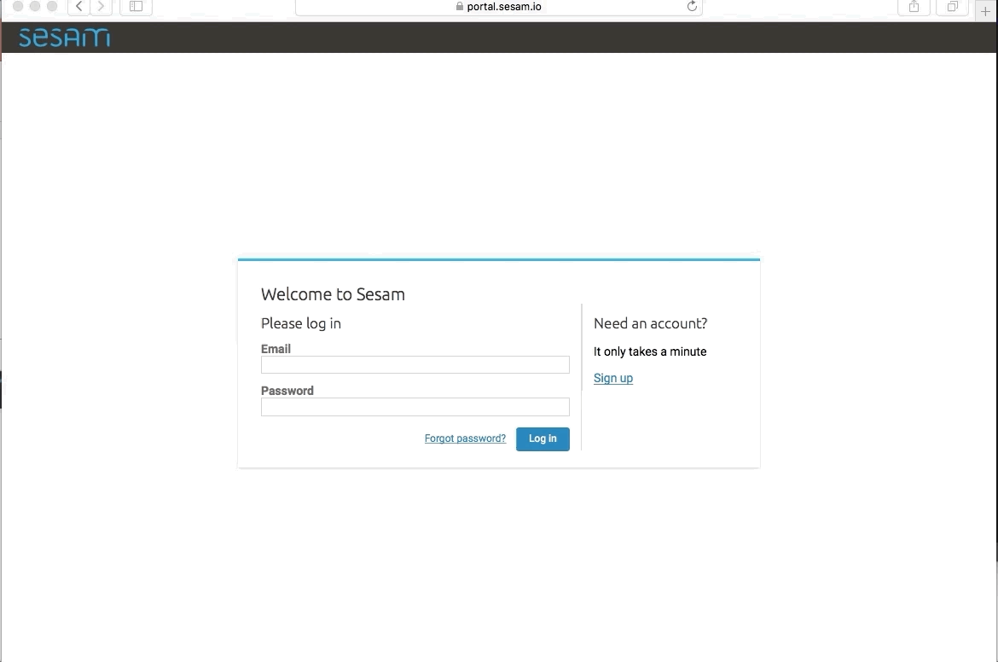
Sesam Portal
Email: sesamtraining@mail.sesam.io
Password: trainsesam1234
https://portal.sesam.io
Notes:
S | G?
Demo time
Pipes, Systems, Datasets, filters in name (wildcard)
Show the docs!
https://docs.sesam.io

Slide 26

The project
global-location
difi-location
difi
crm-person
crm
erp-person
global-person
erp
person-cmm
hr-person
cmm
hr
sf-userprofile
salesforce
(sf)
global-consent
sf-consent
Notes:
G
We have information about our customers in 4 different systems.
We want to grab the best information possible about our customers and send it out to our customer marketing management (CMM).
CRM and HR have very similar information, but Salesforce has subscriptions the customers have signed up for previously.
After GDPR was instated we could no longer rely on the active flags in the pipe erp-person to send customer notifications. Now we are going to check if our user have consented and to what type of marketing they have consented to in their salesforce userprofile.
We are also going to use difi-location (direktoratet for forvaltning og IKT) to grab better location data on our way out.

Slide 27
Lesson 1 - Import data
global-location
difi-location
difi
crm-person
crm
erp-person
global-person
erp
person-cmm
hr-person
cmm
hr
sf-userprofile
salesforce
(sf)
global-consent
sf-consent
Notes:
We have information about our customers in 4 different systems.
We want to grab the best information possible about our customers and send it out to our customer marketing system CMM.
CRM and HR have very similar information, but Salesforce has subscriptions the customers have signed up for previously.
After GDPR was instated we could no longer rely on the active flags in erp-person to send customer notifications, so now we are going to check if our user has consented and to what type of marketing they have consented in salesforce userprofile.
We are also going to use difi-location (Direktoratet for forvaltning og IKT) to grab better location data on our way out.

Slide 28
Lesson 1 - Import data
Scope : Get data from a source system – through a pipe – in to a dataset in Sesam.
Use template to set up pipe:
Name the pipe – ”<yourname>-<system>-<content>”.
Select the source System: crm from template
Table: person
Add DTL Transform
In the default transform rule, add the following:
[”copy”, ”*”], [”add”, ”rdf:type”, ”crm-person”]
Run pipe and look at dataset.
Naming Convention for the Pipe
<name-of-source>-<name-of-object>
Notes:
J
Show the documentation and how to search through it.
Philip will show the database add rdf type Make a change in db and have them run the pipe again to see the change LUNCH BECOMES LESSON 1
Show SQL source- talk about our entire flow of data – from SQL to back
Talking points - Best Practices
- Explain properties
- - Schema Less
- Sink: datasets (DATAHUB)
-
###################
Scope : Get data from a source system – through a pipe – in to a dataset in Sesam.
i. Set up system
- Properties in the system
Usernames/passwords/ports etc.
Secrets and variables
Name/id of everything is important
Set up pipe
Properties
Blocks (Source, Transform, Pump) **sink = implicit**
Run pipe and look at dataset.

Slide 29
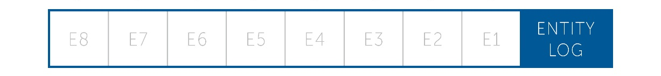
Datasets
In General - a collection of related sets of information that is composed of separate elements but can be manipulated as a unit.
The Sesam Datahub stores data in datasets
In Sesam Each dataset is a log of entities. An entity is a key-value paired JSON dictionary with a unique identifier, “_id”.
Each Entity holds information and can also be referred to as unit of observation.
Notes:
D
We process entities when they have changed. An entity which gets updated is linked to the old one.
Show update of entity in dataset from Lesson 1

Slide 30
What triggers updates? Δ Change tracking
Sesam cares about the current version of entities
Attributes
change/added/deleted
Updates trigger processing by pipes
Notes:
We care about how an entity looks right now, we don’t like versioning

Slide 31
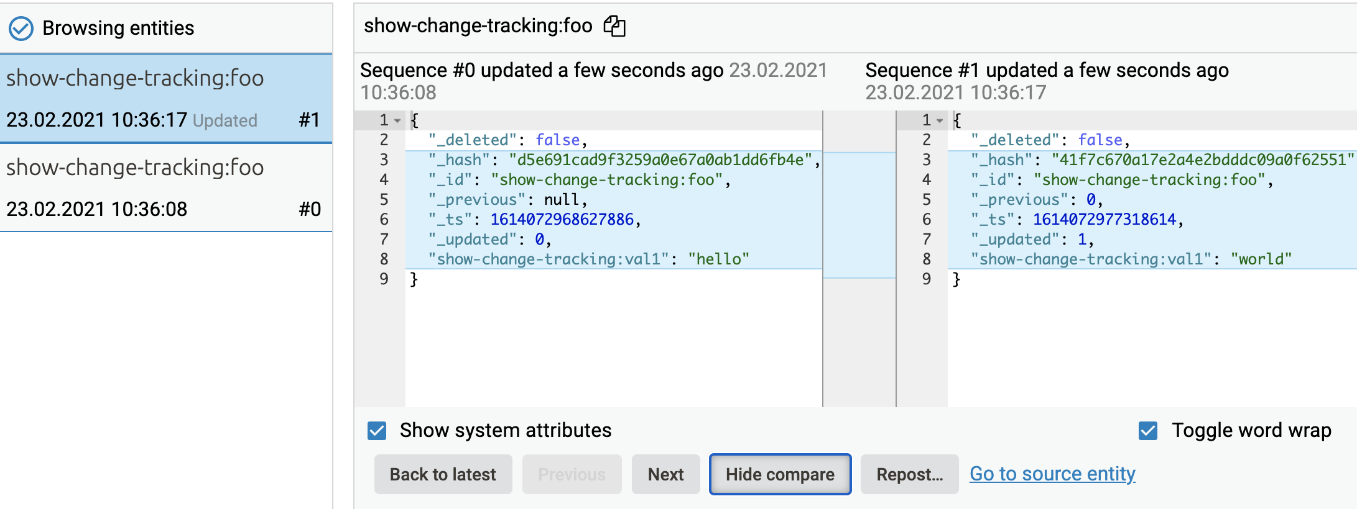

Slide 32
Lunch Break
30’ pause

Slide 33
Merge Data
ID | firstname | lastname
1 | Bob | Marley
2 | Chris | Smith
ID | Lastname | email
1 | Marley | b.marley@cloud.com
2 | Smith | c.smith@cloud.com
ID | firstname | lastname | ID | Lastname | email
1 | Bob | Marley | 1 | Marley | b.marley@cloud.com
2 | Chris | Smith | 2 | Smith | c.smith@cloud.com
Notes:
D
Everywhere where the condition is regarded as true is merged.
Two sets of data that are obviously about the same thing. Can be merged, will look like this.
Merging is about concepts. You don’t want to merge cars brands and people, or customers and orders for example.

Slide 34
Case 1 – Entities of dataset A match B and B matches C
A
B
C
ID | firstname | lastname
1 | Bob | Marley
2 | Chris | Smith
ID | Lastname | email
1 | Marley | b.marley@cloud.com
15 | Ahlberg | p.ahlberg@cloud.com
ID | Age | email
14 | 41 | b.marley@cloud.com
15 | 27 | p.ahlberg@cloud.com
crm-person
erp-person
HR-person
ID | firstname | lastname | ID | Lastname | email | ID | Age | email
1 | Bob | Marley | 1 | Marley | b.marley@cloud.com | 14 | 41 | b.marley@cloud.com
2 | Chris | Smith
 |  |  | 15 | Ahlberg | p.ahlberg@cloud.com | 15 | 27 | p.ahlberg@cloud.com
Notes:
D
Can match ID for A + B and email for B + C
What about last name? Can we match on that?
Even though Chris Smith does not match with anyone, he’s still in the aggregated result

Slide 35
Case 2 – Entities of dataset A ! match B and B matches C
A
B
C
ID | firstname | lastname
1 | Bob | Marley
2 | Chris | Smith
ID | Lastname | email
14 | Jones | i.jones@cloud.com
15 | Ahlberg | p.ahlberg@cloud.com
ID | Age | email
14 | 41 | i.jones@cloud.com
15 | 27 | p.ahlberg@cloud.com
crm-person
erp-person
HRsystem-person
ID | firstname | lastname | ID | Lastname | email | ID | Age | email
1 | Bob | Marley
2 | Chris | Smith
 |  |  | 14 | Jones | i.jones@cloud.com | 14 | 41 | i.jones@cloud.com
 |  |  | 15 | Ahlberg | p.ahlberg@cloud.com | 15 | 27 | p.ahlberg@cloud.com
Notes:
D
Here there are no matches from a to b
But b and c match 100%

Slide 36
Case 3– Entities of dataset A ! match B and B ! match C
A
A
B
B
C
C
ID | firstname | lastname
1 | Bob | Marley
2 | Chris | Smith
ID | Lastname | email
14 | Jones | i.jones@cloud.com
15 | Ahlberg | p.ahlberg@cloud.com
ID | Age | email
1337 | 41 | h.benjamin@cloud.com
4242 | 27 | s.olsen@gmail.com
crm-person
erp-person
HRsystem-person
ID | firstname | lastname | ID | Lastname | email | ID | Age | email
1 | Bob | Marley
2 | Chris | Smith
 |  |  | 14 | Jones | i.jones@cloud.com
 |  |  | 15 | Ahlberg | p.ahlberg@cloud.com
 |  |  |  |  |  | 1337 | 41 | h.benjamin@cloud.com
 |  |  |  |  |  | 4242 | 27 | s.olsen@gmail.com
Notes:
D
This resulting dataset from a merge where no equalities could be found.
Results in separate entities, but the data is still about people so it is probably correct to put them together.
This is done to help getting data out from Sesam, grouping by concept is not required at all, but strongly advised from us that has been doing it for some time.

Slide 37
Dataset A
{
"_id": "a:1",
"a:firstname": "Bob",
"a:lastname": "Marley"
}
Pipe config
Output
{
"_id": "merge-source",
"type": "pipe",
"source": {
"type": "merge",
"datasets": ["A a", "B b"]
"equality": [
["eq", "a.lastname", "b.lastname"]
]
}
}
{
"$ids": ["a:1","b:1"],
"_id": "a:1",
"a:firstname": "Bob",
"a:lastname": "Marley"
"b:lastname": "Marley",
"b:email": "b.marley@cloud.com"
}
Dataset B
{
"_id": "b:1",
"b:lastname": "Marley",
"b:email": "b.marley@cloud.com"
}
Notes:
Daniel
Ask audience: What kind of join is this? One to one? One to many?
Why do we use copy *? What does it do?

Slide 38
Why Merge?
Notes:
S | G?
Ask the audience.

Slide 39
Merging data gives us
Aggregated representation of an object​
Possibility to define "golden properties"​
Option to find reusable properties for an object​
Grouping of data by concept, without using a canonical data model​
Notes:
S | G?
Canonical : The purpose of a CDM is to enable an enterprise to create and distribute a common definition
In its most extreme form, a canon approach would mean having one person, customer, order, product, etc., with a set of IDs, attributes, and associations that the entire enterprise can agree upon.
Common model that all other applications also understand.
Independent source and sink systems ​
Source independent joining of outgoing data
Golden record is the best possible way of describing something with the data we have, it’s a concept and probably nothing we can achieve but we strive for it.

Slide 40
Merge Data Source Configuration
{
"_id": "merge-source",
"type": "pipe",
"source": {
"type": "merge",
"datasets": ["crm-person cp", ”hrsystem-person hr", ”erp-person ep", "salesforce-userprofile sup"],
"equality": [
["eq", "cp.SSN", "hr.SSN"],
["eq", "ep.SSN", "hr.SNN"],
["eq", "cp.Username", "sup.Username"]
],
"identity":"first",
"version": 2
}}
Notes:
S | G?
TO ADD: soap bubbles, explain intersecting equality for merging. Everywhere where the condition is regarded as true is merged.
Two sets of data that are obviously about the same thing. Can be merged, will look like this.
Merging is about concepts. You don’t want to merge cars brands and people, or customers and orders for example.
Identity first is used to use the first id as the "main" id. So its easier to find in searches

Slide 41
Lesson 2 - Merge Data
global-location
difi-location
difi
crm-person
crm
erp-person
global-person
erp
person-cmm
hr-person
cmm
hr
sf-userprofile
salesforce
(sf)
global-consent
sf-consent
Notes:
D
We have information about our customers in 4 different systems.
We want to grab the best information possible about our customers and send it out to our customer marketing system CMM.
CRM and HR have very similar information, but Salesforce has subscriptions the customers have signed up for previously.
After GDPR was instated we could no longer rely on the active flags in erp-person to send customer notifications, so now we are going to check if our user has consented and to what type of marketing they have consented in salesforce userprofile.
We are also going to use difi-location to grab better location data on our way out.

Slide 42
Lesson 2 - Merge Data
Scope : Merge multiple datasets.
Create a new pipe: <yourname>-global-<person>
Use template to:
Select source System – as ’system:sesam-node’
Select source Provider as merge prototype
Enlist the datasets followed by an alias ”crm-person cp”
Find fields which you can use to connect the datasets and determine the ’best’ fields to join on. Specify these in ”equality”.
Best practices…
Merge pipe config example
"datasets": [ "your-dataset yd", "erp-person ep", "hr-person hr", "salesforce-userprofile sup"],
"equality": [ ["eq", "yd.???", "hr.???"], ["eq", "ep.???", ”yd.???"], ["eq" "sup.???", "???.???"] ]
Notes:
D
Talking points
- Equalities
- Information Models (Merging with no EQ)
- Name Spaces, $ids,
- Identities
- Merge source
#####
Data imported, now what? - lets do something, work towards globals. New pipe. Different properties, source now from dataset. Set up EQ, ask pointed questions about what they think.
###################
Discuss with Product - Select the strategy [1], version [1 or 2]. -- Why ? Doc.sesam.io does not cover identity , version, compact as a strategy – however it is used.

Slide 43

Global datasets
Best practise in Sesam
Using rdf types
Namespaces
Buckets for gathering data about concepts/objects
Base for outgoing datasets
Notes:
E | G?
https://www.enterpriseintegrationpatterns.com/ramblings/08_integrationstyles.html
https://www.slideserve.com/dolan/soa-bpm-bpel-jbpm
https://www.hcltech.com/blogs/significance-system-integration
Namespace
RDF TYPE

Slide 44

Sesam without global datasets
Notes:
E | G?

Slide 45

Sesam with Global datasets & Endpoints
Notes:
E | G?

Slide 46
Lesson 3 - Enhancing Data
global-location
difi-location
difi
crm-person
crm
erp-person
global-person
erp
person-cmm
hr-person
cmm
hr
sf-userprofile
salesforce
(sf)
global-consent
sf-consent
Notes:
J
We have information about our customers in 4 different systems.
We want to grab the best information possible about our customers and send it out to our customer marketing system CMM.
CRM and HR have very similar information, but Salesforce has subscriptions the customers have signed up for previously.
After GDPR was instated we could no longer rely on the active flags in erp-person to send customer notifications, so now we are going to check if our user has consented and to what type of marketing they have consented in salesforce userprofile.
We are also going to use difi-location to grab better location data on our way out.

Slide 47
Lesson 3 - Enhancing Data
Scope : Enhancing the Quality of data
Copy everything [”copy”, ”*”]
Add global properties specified here ------->
Prioritize source of global fields with ”coalesce” expression
Namespaces usage
”_S.erp-person:firstname” returns a specific firstname from specific namespace.
”_S.firstname” ignores namespaces and returns all ”firstname” fields as a list
Best Practices
Global properties
fullname
zipcode
email
firstname
lastname
Functions
[”coalesce”, [”list”, null, 1, 2]] -> 1
[”concat”, [”foo”, ”bar”]] -> ”foobar”
[”if”, true, ”a”, ”b”] -> ”a”
[”if”, false, ”a”, ”b”] -> ”b”
Notes:
J
BEST practices – coalesce for global properties

Slide 48
Golden Record
Prioritize attribute origin
Which systems knows the attribute best?
Which system knows the attribute second best?
Master data management
Create a flexible system-wide model
Re-use golden properties downstream
The more pipes you make, the more time you save
Golden attributes added in the global

Slide 49

Joins
Full outer Join
Left Join
Notes:
S | G?

Slide 50
Merge source
Hops
A
B
A
B
C
C
All entities from A & B end up in C
Joined entities merge into one entity
Unjoined entities are still seperate
All entities from A ends up in C
Joined entities has appended data from B
Notes:
S | G?
Merge: All data from A & B end up in output, we join what can be joined.
Hops: All data from A ends up in output, with data from B added to the ones which joined.
Hops, similar to merge, but with key differences.
Hops are similar in nature to merge, but there are some key differences:
The equalities does not intersect. They can be chained, ["and"]/["or"]
IMPLICIT and if OR is needed needs to be explicit
In hops you can also filter on the dataset you hop to, and only equalities with two different datasets will be regarded as an equality. The other will be the filter.
You can chain hops and the equalities are transative, which means that its inferred if a=b=c
*** HERE WE CAN TALK ABOUT MAKE-NI/ FOREIGN KEYS IN ADVANCED***
Here we hop from customers/person to orders based on custno, where it matches we return the entities and add them to the resulting target.
You don't want to merge different concepts so therefore you hop.
There is nothing that keeps you from hopping to other concepts, rather it is the way to get information in one dataset about several different concepts.
Dependency tracking

Slide 51
Hops DTL
"transform": {
"type": "dtl",
"rules": {
"default": [
["copy", "*"],
["add", "address-data",
["hops", {
"datasets": ["global-location gl"],
"where": [
["eq", "_S.zipcode", "gl.postnummer"]
]
}]
]
}}
Notes:
S | G?
Point out _S. value and gl. Value. Source is a dataset, but we hop to another.
Philip – please add the resultant dataset
This is the block we use for hops
We hop to specified dataset, we use an OR for equalities and we add a block of address-data.
We can merge to get it flat.
Show example in the node:
https://portal.sesam.io/unified/subscription/2317534d-4c01-4e29-8970-6ea165416ef2/pipes/pipe/example-joins-one/edit

Slide 52
Joins & Intersection
One to One
["eq", "a", "b"]
One to to Many
["eq", "a", "list"]
Many to Many
["eq", "list", "list"]
"Eq" is intersection in join expressions!
It checks for equality in other expressions
Notes:
G
Merges connect data together
The «equality» checks the intersection of the values.
Values in this case: people.Emails user.EmailAddress.
Because paull@sesam.io is part of the Emails list then this equality will be true
This is a Many to One/One to Many Join
Can ask the question: “What would happen if we joined with multiple accounts?” ”How would the output look like then?” “Would the values override eachother?”
Show one to many example in the node:
https://portal.sesam.io/unified/subscription/2317534d-4c01-4e29-8970-6ea165416ef2/pipes/pipe/example-joins-many/edit

Slide 53
HOPS
custno | firstname | lastname
001 | Bob | Marley
002 | Chris | Smith
orderno | articleno | custno
1 | 10006234 | 001
2 | 10005231 | 001
3 | 10003251 | 002
4 | 10003291 | 003
custno | firstname | lastname | orderno | articleno
001 | Bob | Marley | 1 | 10006234
 |  |  | 2 | 10005231
002 | Chris | Smith | 3 | 10003251
Notes:
S | G?
Moved other notes to 52

Slide 54
Pipe config
Source entity
"transforms":{
"rules":[
"default": [
["copy", "*"],
["add", "hopping",
["hops", {
"datasets":["orders o"],
"where": ["eq", "_S.custno", "o.custno"]}]]]]}
Entities in «orders»
{
"custno": "001",
"firstname": "Bob",
"lastname": "Marley"
}
[{
"orderno": "1",
"articleno": "10006234",
"custno": "001"
},{
"orderno": "2",
"articleno": "10005231",
"custno": "001"
}]
Output
{
"firstname": "Bob",
"lastname": "Marley",
"custno": "001",
"hopping": [{
"orderno": "1",
"articleno": "10006234",
"custno": "001"
}, {
"orderno": "2",
"articleno": "10005231",
"custno": "001"
}]
}
Notes:
S | G?
Ask audience: What kind of join is this? One to one? One to many?
Why do we use copy *? What does it do?

Slide 55
Dependency Tracking
Tracks dependencies between datasets
Trigger re-processing based on updates hopped-to-data outside of your source
Data outside your source is defined by hops
Avoids unnecessary pipe restarts
Keeps your data up-to-date
On by default – you may need to turn it off sometimes
Dependency tracking memory thresholds
Default threshold: 1 – 50K relations or 128mb RAM

Slide 56
Playing the short game:
Sesam without best practice
Notes:
E | G?

Slide 57
Playing the long game: Sesam with best practice
Notes:
E | G?

Slide 58
Playing the long game - Input
The core of data-driven integrations
Keep the input data raw
Reusability
Debugging
Exceptions (p.s: we don’t stop you)
Tagging – RDF:type
Namespaces remembers attribute origin for you
Referencing foreign keys

Slide 59
Playing the long game - Globals
Globals - Inefficiency at scale is great (because it scales)
Interface between source data and output data
Semantic grouping
Easier to understand the data
One place to go – fewer active connectons
It’s about your data and what it represents, not where it comes from
Golden attributes & Record
Notes:
Modular design

Slide 60
Playing the long game - Preparation
Collect the data you want
Source: Global or Prep
Hops to global datasets
Prepare data for target system
Keep in mind what will trigger updates
Idempotency
Filter on rdf:type
Use namespaces

Slide 61
Endpoint
Connects to target systems
Easier to debug
Scales
Do system specific filtering
Endpoint pipes should not transform data
Can add update values if needed

Slide 62
Total
Collect the data you want
Source: Global or Prep
Hops to global datasets
Prepare data for target system
Keep in mind what will trigger updates
Idempotency
Filter on rdf:type
Use namespaces
Think long game, not short and quick solutions

Slide 63
Quick Recap
Notes:
Start dag 2
G

Slide 64

So far…
Integration Architectures
Sesam Data Model
Basic Concepts of Sesam
Systems (datasource, sinks)
Pipes
Datasets
What an Entity is
Joining Data
i. Merge
ii. Hops
Globals
Global/Golden attributes
Namespaced Identifiers
Pipe Flow / Long game
Input, Global, Preparation, Endpoint
Hands On Exercises
Import data from a system
Creating Globals (Merge Data)
Enhancing data (Global properties)
Notes:
G
How far did we go yesterday?

Slide 65
Integration Architectures
Point to point
Enterprise service bus (ESB)
Data driven
Notes:
E | G?
https://www.enterpriseintegrationpatterns.com/ramblings/08_integrationstyles.html
https://www.slideserve.com/dolan/soa-bpm-bpel-jbpm
https://www.hcltech.com/blogs/significance-system-integration

Slide 66
Point to point
Notes:
E | G?
https://www.enterpriseintegrationpatterns.com/ramblings/08_integrationstyles.html
https://www.slideserve.com/dolan/soa-bpm-bpel-jbpm
https://www.hcltech.com/blogs/significance-system-integratio
n

Slide 67
Enterprise service bus
Notes:
J | G?
Centralized messaging backbone- distributed integration tasks An ESB is bus based integrtaion providing a central place for the services, applications, and IT resources in general that you want to connect.”

Slide 68
Sesam data Model
Collect, connect and share
Powerful modularity
JSON internally
Built in Connectors / Interfaces
Microservices
Collect to abstract away data sources
First priority is the Data
Connect to enhance & Simplify
Prioritize the most truthful data across sources
Aggregate object information
Share according to external requirements
Multiple interfaces, schedules, full/incremental
Data-oriented mindset.
What data is needed where and when?
How to use the data instead of how to get it.
Notes:
Gabbe ? Erik / Jonas Internally we translate everything to JSON
What is JSON? Anyone familiar with it ?
JSON
human-readable text to transmit data objects consisting of attribute–value pairs (or serialized)
Language independent, dervived from JS
Async communcation browser-server, most common nowadays
Don’t assume what the data will be used for, in general.
Copying data, was bad, is now good. Finds uses for it.
Talk about the bulks we have in sesam. A, B, C people, orders, companies?
Delta updates, hashed entities and compare, deterministic vs non-deterministic lists f.eks

Slide 69
Sesam Concepts
Systems
Data source
Data sink
Pipes
Datasets
Notes:
S | G?
Focus on input & output pipes
Core concepts, we will go through these and start with hands on along with that.
System – externt, gets data to input, prepares, sends with output to external system again.

Slide 70
Sesam without global datasets
Notes:
E | G?

Slide 71
Sesam with Global datasets & Endpoints
Notes:
E | G?

Slide 72
The project
global-location
difi-location
difi
crm-person
crm
erp-person
global-person
erp
person-cmm
hr-person
cmm
hr
sf-userprofile
salesforce
(sf)
global-consent
sf-consent
Notes:
J
We have information about our customers in 4 different systems.
We want to grab the best information possible about our customers and send it out to our customer marketing system CMM.
CRM and HR have very similar information, but Salesforce has subscriptions the customers have signed up for previously.
After GDPR was instated we could no longer rely on the active flags in erp-person to send customer notifications, so now we are going to check if our user has consented and to what type of marketing they have consented in salesforce userprofile.
We are also going to use difi-location to grab better location data on our way out.

Slide 73
RDF Types
Notes:
A
Short Break Go to portal and show the rdf types
Skip??

Slide 74
Joins
Full outer Join
Left Join
Notes:
A

Slide 75
Merge source
Hops
A
B
A
B
C
C
All entities from A & B end up in C
Joined entities merge into one entity
Unjoined entities are still seperate
All entities from A ends up in C
Joined entities has appended data from B
Notes:
A
Merge: All data from A & B end up in output, we join what can be joined.
Hops: All data from A ends up in output, with data from B added to the ones which joined.
Hops, similar to merge, but with key differences.
Hops are similar in nature to merge, but there are some key differences:
The equalities does not intersect. They can be chained, ["and"]/["or"]
IMPLICIT and if OR is needed needs to be explicit
In hops you can also filter on the dataset you hop to, and only equalities with two different datasets will be regarded as an equality. The other will be the filter.
You can chain hops and the equalities are transative, which means that its inferred if a=b=c
*** HERE WE CAN TALK ABOUT MAKE-NI/ FOREIGN KEYS IN ADVANCED***
Here we hop from customers/person to orders based on custno, where it matches we return the entities and add them to the resulting target.
You don't want to merge different concepts so therefore you hop.
There is nothing that keeps you from hopping to other concepts, rather it is the way to get information in one dataset about several different concepts.
Dependency tracking

Slide 76
Joins & Intersection
One to One
["eq", "a", "b"]
One to to Many
["eq", "a", "list"]
Many to Many
["eq", "list", "list"]
"Eq" is intersection in join expressions!
It checks for equality in other expressions
Notes:
G
Merges connect data together
The «equality» checks the intersection of the values.
Values in this case: people.Emails user.EmailAddress.
Because paull@sesam.io is part of the Emails list then this equality will be true
This is a Many to One/One to Many Join
Can ask the question: “What would happen if we joined with multiple accounts?” ”How would the output look like then?” “Would the values override eachother?”
Show one to many example in the node:
https://portal.sesam.io/unified/subscription/2317534d-4c01-4e29-8970-6ea165416ef2/pipes/pipe/example-joins-many/edit

Slide 77
Hops DTL
"transform": {
"type": "dtl",
"rules": {
"default": [
["copy", "*"],
["add", "address-data",
["hops", {
"datasets": ["global-location gl"],
"where": [
["eq", "_S.zipcode", "gl.postnummer"]
]
}]
]
}}
Notes:
Point out _S. value and gl. Value. Source is a dataset, but we hop to another.
Philip – please add the resultant dataset
This is the block we use for hops
We hop to specified dataset, we use an OR for equalities and we add a block of address-data.
We can merge to get it flat.
Show example in the node:
https://portal.sesam.io/unified/subscription/2317534d-4c01-4e29-8970-6ea165416ef2/pipes/pipe/example-joins-one/edit

Slide 78
HOPS
custno | firstname | lastname
001 | Bob | Marley
002 | Chris | Smith
orderno | articleno | custno
1 | 10006234 | 001
2 | 10005231 | 001
3 | 10003251 | 002
4 | 10003291 | 003
custno | firstname | lastname | orderno | articleno
001 | Bob | Marley | 1 | 10006234
 |  |  | 2 | 10005231
002 | Chris | Smith | 3 | 10003251
Notes:
Moved other notes to 52

Slide 79
Pipe config
Source entity
"transforms":{
"rules":[
"default": [
["copy", "*"],
["add", "hopping",
["hops", {
"datasets":["orders o"],
"where": ["eq", "_S.custno", "o.custno"]}]]]]}
Entities in «orders»
{
"custno": "001",
"firstname": "Bob",
"lastname": "Marley"
}
[{
"orderno": "1",
"articleno": "10006234",
"custno": "001"
},{
"orderno": "2",
"articleno": "10005231",
"custno": "001"
}]
Output
{
"firstname": "Bob",
"lastname": "Marley",
"custno": "001",
"hopping": [{
"orderno": "1",
"articleno": "10006234",
"custno": "001"
}, {
"orderno": "2",
"articleno": "10005231",
"custno": "001"
}]
}
Notes:
Ask audience: What kind of join is this? One to one? One to many?
Why do we use copy *? What does it do?

Slide 80
Recap done break!
Notes:
Start dag 2
G

Slide 81
DTL
Data Transformation Language
Notes:
D
Is the Sesam Data Transformation Language
Designed for transforming an entity from one shape into another
A simple data building language
- Add property called X with value Y

Slide 82
{
"_id" : "1",
"firstname" : "Ola",
"lastname" : "Andersen"
}
To access the value of lastname, use the key. Example:
lastname -> Andersen
JSON entities / dictionaries
lastname
Andersen
Key
Key - Value pair
Value
Notes:
D

Slide 83

Source & Target
Source
Each pipe has an Input and Output
We call it Source and Target in DTL
You access them with _S & _T
Target
Notes:
D Each pipe has an Input and an Output
We call it Source and Target in DTL
You access them with _S & _T

Slide 84
Source & Target
{
"_id" : "1",
"firstname" : "Ola",
"lastname" : "Andersen"
}
Source
["copy", "*"],
["add", "fullname",
["concat", "_S.firstname", " ", "_S.lastname"]],
["add", "greeting",
["concat", "Hei ", "_T.fullname", "!"]]
{
"_id" : "1",
"firstname" : "Ola",
"lastname" : "Andersen",
"fullname" : "Ola Andersen",
"greeting" : "Hei Ola Andersen!"
}
Target
Notes:
D
See how these fields match? We say pull from the _S, and grab lastname
Also, you can use the target and pull from _T.
https://beta.portal.sesam.in/unified/subscription/2317534d-4c01-4e29-8970-6ea165416ef2/pipes/pipe/Copy%20of%20example-source-target/edit

Slide 85
{
"_id": "crm-person",
"type": "pipe",
"source": {
"type": "dataset",
"dataset": "person"
},
"transform": {
"type": "dtl",
"rules": {
"default": [
]
]
}
}
}
Source & Target
{
"_id" : "1",
"firstname" : "Ola",
"lastname" : "Andersen"
}
Source
["copy", "*"],
["add", "fullname",
["concat", "_S.firstname", " ", "_S.lastname"]],
["add", "greeting",
["concat", "Hei ", "_T.fullname", "!"]]
{
"_id" : "1",
"firstname" : "Ola",
"lastname" : "Andersen",
"fullname" : "Ola Andersen",
"greeting" : "Hei Ola Andersen!"
}
Target
Notes:
D
Each pipe has an Input and an Output
We call it Source and Target in DTL
You access them with _S & _T
https://beta.portal.sesam.in/unified/subscription/2317534d-4c01-4e29-8970-6ea165416ef2/pipes/pipe/Copy%20of%20example-source-target/edit

Slide 86
Transform functions
Add or remove key:value pairs to/from Target
["add", "key", "value"]
["copy", "key"]
["remove", "key"]
["rename", "old-key", "new-key"]
["merge", "dictionary"]
["merge-union", "dictionary"]
Notes:
S | G?
Introduction to docs.sesam.io

Slide 87
Transform functions
{
"_id":"1",
"firstname":"Pauline",
"lastname":"Larsen"
}
Source
["copy", "*"],
["remove", "firstname"]
["copy", "*"],
["add", "hello", "world"]
["rename", "firstname", "givenname"]
Transform
{
"_id":"1",
"givenname":"Pauline"
}
{
"_id":"1",
"lastname":"Larsen"
}
{
"_id":"1",
"firstname":"Pauline",
"lastname":"Larsen",
"hello":"world"
}
Target
Notes:
S | G?

Slide 88
Expression functions
Return a value based on input Result:
["concat", "Hello ", "world!"] -> "Hello world!"
["coalesce", ["list", null, null, "Hello"]] -> "Hello"
["eq", 1, 1] -> true
Notes:
S | G?

Slide 89
Expression functions
{
"_id":"1",
"firstname":"Pauline",
"lastname":"Larsen",
}
Source
["copy", "_id"],
["add", "fullname", ["concat", "_S.firstname", " ", "_S.lastname"] ]
["copy", "*"],
["add", "bool",
["eq", true, false]]
Transform
{
"_id":"1",
"fullname":"Pauline Larsen"
}
{
"_id":"1",
"firstname":"Pauline",
"lastname":"Larsen",
"bool": false
}
Target
Notes:
S | G?

Slide 90
Sesam Portal
Email: sesamtraining@mail.sesam.io
Password: trainsesam1234
https://portal.sesam.io
Notes:
S | G?
Demo time
Pipes, Systems, Datasets, filters in name (wildcard)
Show the docs!
https://docs.sesam.io

Slide 91
Lesson 4 - Shaping data
global-location
difi-location
difi
crm-person
crm
erp-person
global-person
erp
person-cmm
hr-person
cmm
hr
sf-userprofile
salesforce
(sf)
global-consent
sf-consent
Notes:
A We have information about our customers in 4 different systems.
We want to grab the best information possible about our customers and send it out to our customer marketing system CMM.
CRM and HR have very similar information, but Salesforce has subscriptions the customers have signed up for previously.
After GDPR was instated we could no longer rely on the active flags in erp-person to send customer notifications, so now we are going to check if our user has consented and to what type of marketing they have consented in salesforce userprofile.
We are also going to use difi-location to grab better location data on our way out.

Slide 92
Lesson 4 - Shaping Data
Scope : Shaping & filtering data based on recieving system.
Create new pipe named ”<yourname-person-CMM>
Use template to:
Select Source: system:sesam-node Provider: <yourname>-global-person
Add transform
Filter on ”~:erp:person” & ”~:salesforce:userprofile” rdf types
Combine functions shown in the sidebar→
Copy global properties
Target Properties
All ‘global’ properties
Functions
["filter", <boolean>]
["in", ["list", "~:erp:person","~:salesforce:userprofile"], "_S.rdf:type"]
Notes:
A
Why store output data in a dataset and not send directly?
Delta
What we sent
Versions/history
Debug
Inclusive in nature (Filter)
Show example: https://portal.sesam.io/unified/subscription/2317534d-4c01-4e29-8970-6ea165416ef2/pipes/pipe/example-apply-rule/edit

Slide 93
Apply expression & `_S.`
Apply transforms one or more entities based on a rule
DTL way of context switching & functions
It takes a user defined rule and any value as input.
Most useful for 1 or more dictionaries.
‘_S.’ is context dependent.
E.g: Inside a rule ‘_S.’ points to the rules parameter.
Notes:
Example pipe config:https://portal.sesam.io/unified/subscription/2317534d-4c01-4e29-8970-6ea165416ef2/pipes/pipe/example-apply-rule/edit
Ask audience: where does the for the default rule point?

Slide 94
Apply expression & `_S.`
Source entity
Pipe config
Output
{
"_id":"secret"
"employments":[{
"firstname":"James",
"lastname":"Bond",
"employee_id":"007"
"company":"MI7"
},{
"firstname": "Arlington",
"lastname", "Beech",
"employee_id":"1337",
"company":"casino royale"
}]
}
"transforms":{
"rules": [
"default": [
["add", "cleaned",
["apply", "fullname", "_S.employments"]]
],
"fullname": [
["copy", "company"]
["add", "fullname",
["concat","_S.firstname"," ","_S.lastname"]
]]]}
{
"_id":"secret",
"cleaned":[{
"fullname":"James Bond",
"company":"MI7"
},{
"fullname": "Arlington Beech",
"company":"casino royale"
}]
}
Notes:
Example pipe config:https://portal.sesam.io/unified/subscription/2317534d-4c01-4e29-8970-6ea165416ef2/pipes/pipe/example-apply-rule/edit

Slide 95
Lesson 5 - User defined rules - apply
global-location
difi-location
difi
crm-person
crm
erp-person
global-person
erp
person-cmm
hr-person
cmm
hr
sf-userprofile
salesforce
(sf)
global-consent
sf-consent
Notes:
G
We have information about our customers in 4 different systems.
We want to grab the best information possible about our customers and send it out to our customer marketing system CMM.
CRM and HR have very similar information, but Salesforce has subscriptions the customers have signed up for previously.
After GDPR was instated we could no longer rely on the active flags in erp-person to send customer notifications, so now we are going to check if our user has consented and to what type of marketing they have consented in salesforce userprofile.
We are also going to use difi-location to grab better location data on our way out.

Slide 96
Lesson 5 - User defined rules - apply
Scope : Cleaning the subscriptions list
Add the result of an ”apply” function used on subscriptions with a user defined rule as shown in the sidebar
Inside your rule:
Add filter on active being true.
Copy category and start date.
NB! Inside your rule ’_S.’ points to what you pass into it
Target Properties
All ‘global’ properties
Subscriptions
Rule definition
"transform": {
"type": "dtl",
"rules": {
"default": [ …
[”add", ”cleaned_subscriptions”
["apply", "your-rule", "_S.subscriptions"]
]
],
"your-rule":[]
}}
Notes:
G
Why store output data in a dataset and not send directly?
Delta
What we sent
Versions/history
Debug
Inclusive in nature (Filter)
Show example: https://portal.sesam.io/unified/subscription/2317534d-4c01-4e29-8970-6ea165416ef2/pipes/pipe/example-apply-rule/edit

Slide 97
Pipe config
Source entity
"transforms":{
"rules":[
"default": [
["copy", "*"],
["add", "hopping",
["hops", {
"datasets":["orders o"],
"where": ["eq", "_S.custno", "o.custno"]}]]]]}
Entities in «orders»
{
"custno": "001",
"firstname": "Bob",
"lastname": "Marley"
}
[{
"orderno": "1",
"articleno": "10006234",
"custno": "001"
},{
"orderno": "2",
"articleno": "10005231",
"custno": "001"
}]
Output
{
"firstname": "Bob",
"lastname": "Marley",
"custno": "001",
"hopping": [{
"orderno": "1",
"articleno": "10006234",
"custno": "001"
}, {
"orderno": "2",
"articleno": "10005231",
"custno": "001"
}]
}
Notes:
Ask audience: What kind of join is this? One to one? One to many?
Why do we use copy *? What does it do?

Slide 98
Lesson 6 - Appending consent data
global-location
difi-location
difi
crm-person
crm
erp-person
global-person
erp
person-cmm
hr-person
cmm
hr
sf-userprofile
salesforce
(sf)
global-consent
sf-consent
Notes:
D
Hop to global consent using the salesforce username

Slide 99
Lesson 6 - Appending consent data
Scope : Append entities with data from global-consent
Use ”add” transform function to add hops expression as shown in sidebar
Join on Username
Check the global-consent dataset to get the key name!
Filter on the hop not returning any entities. TIP: Use _T. On the returned data.
Extra: Filter out consents where HasConsented is false.
More extra: Apply a rule to the returned list
Hops definition
[”add”, ”consents”, [”hops”, { ”datasets”: [”global-consent gc”, ”where”: [”eq”, ”_S.???:Username”, ”gc.???”] }]
],
Functions
[”filter”, <boolean>]
[”neq”, 0, 0] -> True
[”count”, []] -> 0
[”count”, [1, 2, 3]] -> 3
Notes:
D
Ask them if they know what kind of join this is.
Which of the returned entities do we need?

Slide 100
Lesson 7 - Appending location data
global-location
difi-location
difi
crm-person
crm
erp-person
global-person
erp
person-cmm
hr-person
cmm
hr
sf-userprofile
salesforce
(sf)
global-consent
sf-consent
Notes:
J
We want to improve location info for our customers.

Slide 101
Lesson 7 - Appending location data
Scope : Append entities with data from global-location
Add a rule ”location” as shown in the sidebar.
We come back to this rule in step 4.
Use ”merge” or ”add” transform function to add ”apply-hops” expression as shown in sidebar
Join on zipcode
Check the global-location dataset to get the key name!
Copy the city and municipality inside your location rule.
’Kommunenavn’ & ’poststed’
NB! The source in the location rule is the entities you join on in the dataset you have hopped to!
Functions
[”merge”, [” apply-hops”, …]] [”add”, ”hopresult”, [” apply-hops”, …]]
Rules & apply-hops
”default”[
…
[”merge” [”apply-hops”, ”location”, { ”datasets”: [”global-location gl”, ”where”: [”eq”, ”_S. global:Zipcode”, ”gl.?”] }]],
”location":[
[<fill-me-out>]
]
Notes:
J
Talk about functions and how they are useful for shaping data.
You can pass any dictionary into a function and use logic to get the output you want, just as you can with a normal transform.

Slide 102
Lesson 8 - Publishing Data
global-location
difi-location
difi
crm-person
crm
erp-person
global-person
erp
person-cmm
hr-person
cmm
hr
person-cmm-endpoint
sf-userprofile
salesforce
(sf)
global-consent
sf-consent
Notes:
D
We have information about our customers in 4 different systems.
We want to grab the best information possible about our customers and send it out to our customer marketing system CMM.
CRM and HR have very similar information, but Salesforce has subscriptions the customers have signed up for previously.
After GDPR was instated we could no longer rely on the active flags in erp-person to send customer notifications, so now we are going to check if our user has consented and to what type of marketing they have consented in salesforce userprofile.
We are also going to use difi-location to grab better location data on our way out.

Slide 103
Lesson 8 - Publishing Data
Scope : Publishing data to Firebase Realtime Database
- Create new pipe: <name-of-source-dataset>-endpoint
- Add timestamp
- Sink system: CMM
- Sink url: ”<your-name>”
Login: training.firebase@gmail.com
Pwd: SesamTraining2019
Expression functions
[”now”]
[”datetime-format”, ”formatstring”, ”datetime"]
Notes:
D
Publishing to firebase
Each user sets the url as their name. This will create a table for their name.
The microservice also supports deletes
Talk about why we want to add timestamp property in the endpoint pipe and not the dataset
Log in to https://firebase.google.com to check out results: E-mail: training.firebase@gmail.com Password: SesamTraining2019

Slide 104
External Transforms
Microservices
Notes:
J
Introduce MICROSERVICES
Where you would use one
What it does?
Where will we use it?

Slide 105
Pipe Review
Dataset - Entities
Transform – DTL
Input entities, Outputs entities
Dataset - Entities
Notes:
J
105

Slide 106
External Transforms
When DTL and other built in transforms are not enough
When the whole dataset is not available
E.g. lookup current weather
Notes:
J IOT data – may be not stored in sesam
No relation to anything else and lots of data
This transform performs HTTP POST requests to a HTTP capable endpoint. The service at the endpoint then transforms the entities contained in the request body and returns them in the HTTP response message .
106

Slide 107
External Transform Concept
External REST Based Service
Result of request returned to pipe
Entities Sent to MS
Dataset - Entities
Transform – DTL
Input entities, Outputs entities
Dataset - Entities
Notes:
J
107

Slide 108
External Transform Service
The External Transform must be an HTTP based rest service described in Sesam as a System.
URL system or Microservice System
Notes:
J
LOOM UP CURRENT WEATHER
HOW TRANSFORM ACTUALLY WORKS
TYPE OF TRANSFORM AS HTTP
https://docs.sesam.io/configuration.html#the-rest-transform
108

Slide 109
Example System
{
"_id": "openweather",
"type": "system:rest",
"operations": {
"get-weather": {
"headers": {
"Content-type": "application/json"
},
"method": "GET",
"payload-type": "json",
"url": "{{ zip }},no&$SECRET(weather-forecast-apikey)"
}
},
"url_pattern": "https://api.openweathermap.org/data/2.5/weather?zip=%s",
"verify_ssl": true
}
Notes:
J
109

Slide 110
Example Pipe Config
{
"_id": "difi-weather-forecast",
"type": "pipe",
"source": {
"type": "dataset",
"dataset": "global-location"
},
"transform": {
"type": "rest",
"system": "openweather"
}
}
Notes:
J
110

Slide 111
Lesson 9 - External Transform
Transform config
"transform": [{
"type": "dtl",
"rules": {
"default": [
["filter", ["eq", "_S.postnummer", "0281"]],
["copy", "*"],
["add", "::operation", "get-weather"],
["add", "::zip", "_S.difi-postnummer:postnummer"]
]
}
}, {
"type": "rest",
"system": "openweather"
}, { ... }]
Scope : Create new pipe with external transform
- Source: global-location
- Grab the temperature & weather-description
- 0˚C = 273.15 K
- Filter on your own/any postnummer
Extra info: :: removes the namespace Use ”Add DTL transform” from template multiple times.
Notes:
S
BEST practices – Metadata, tags
Consent management perhaps, find filter etc-
Hop to consent pipe, filter people who have – use global person as source

Slide 112
Extra lesson – Zip fix
Scope : Fix input data so that all zipcodes contains 4 characters
Create a new pipe
- Source: crm-store.
- Add new property with fix for zipcodes.
Expression templates
[”is-string”, input] -> boolean [”is-integer”, input] -> boolean [”length”, string] -> int
Expression examples
[”substring”, 1, 3, ”abcd”] -> ”bc”
Notes:
J

Slide 113
Lesson 8 - Setup API/Microservice
Scope : Get data from a source system – through a pipe – in to a dataset in Sesam.
i. Set up pipe
- Properties : Blocks (Source, Transform, Pump)
- Name the pipe – ”<yourname>-<system>-<content>”
- Select the source type from template
- Depending on PK, might have to add transform and
["copy", "*"],
["add", "_id", "_S.SOMEID"]
ii. Run pipe and look at dataset.
Naming Convention for the Pipe
Input pipe: <name-of-source>-<name-of-object>
Internal pipe: global-<name-of-object>
Internal pipe: <purpose>-<name-of-object>
Outgoing pipe: <name-of-object>-<name-of-sink>
Output pipe: <name-of-object>-<name-of-sink>-endpoint
Notes:
USER AKER OR IF NOT AT AKER: FIREBASE FOR THIS
Show SQL source- talk about our entire flow of data – from SQL to back
Talking points - Best Practices
- Explain properties
- - Schema Less
- Sink: datasets (DATAHUB)
-
###################
Scope : Get data from a source system – through a pipe – in to a dataset in Sesam.
i. Set up system
- Properties in the system
Usernames/passwords/ports etc.
Secrets and variables
Name/id of everything is important
Set up pipe
Properties
Blocks (Source, Transform, Pump) **sink = implicit**
Run pipe and look at dataset.

Slide 114
Lesson 7 – creating SQL Data
Scope : Create a new table in database (if it doesn't exist) when running output pipe
- Create new pipe, add source as dataset, transform & SINK.
- STORE CRM END PIPE COPY TO person CRM endpoimt and make it work
-Specify the database schema
-Look in the docs.
Naming Convention for the Pipe
Input pipe: <name-of-source>-<name-of-object>
Internal pipe: global-<name-of-object>
Internal pipe: <purpose>-<name-of-object>
Outgoing pipe: <name-of-object>-<name-of-sink>
Output pipe: <name-of-object>-<name-of-sink>-endpoint
Notes:
Target Entity from lesson 4 is posted to sql table
Fix schema so that it matches the data. We can also use consents to filter out people here. If that works for you.
Database schema needs to be tested for the output of the lesson4/6 target entity

Slide 115
Lesson 8 - Publishing Data
Scope : Publishing data to Sink [external system/ endpoint]
- Create new pipe, add source as dataset, transform & SINK.
- Add timestamps (if needed, if supported)
- Push data out.
- csv endpoint
Naming Convention for the Pipe
Input pipe: <name-of-source>-<name-of-object>
Internal pipe: global-<name-of-object>
Internal pipe: <purpose>-<name-of-object>
Outgoing pipe: <name-of-object>-<name-of-sink>
Output pipe: <name-of-object>-<name-of-sink>-endpoint
Notes:
ENJOY
API? Pubsub?

Slide 116
Lesson 9 – Get data from csv endpoint
Scope : Publishing to Sink [external system/ endpoint]
- Create new pipe, add source as dataset, transform & SINK.
- Use cURL to download csv file from csv endpoint
Naming Convention for the Pipe
Input pipe: <name-of-source>-<name-of-object>
Internal pipe: global-<name-of-object>
Internal pipe: <purpose>-<name-of-object>
Outgoing pipe: <name-of-object>-<name-of-sink>
Output pipe: <name-of-object>-<name-of-sink>-endpoint
Notes:
Publish some data to csvendpoint and get it down in a lesson, might be just something for show.
Talk about API and JWT
Show API/Sesam Client ?

Slide 117
Notifications/monitoring
Scope : Getting an introduction to how notifications work on pipes
See what the different options are for notifications
Get a look at execution datasets and some key features to look for
Discussion about how to set this up
Notes:
E
Notifications/monitoring
Automatic update of status page using microservice
Execution-log
https://portal.sesam.io/unified/subscription/2317534d-4c01-4e29-8970-6ea165416ef2/pipes/pipe/person-cdp-endpoint/notifications
Part of the pipe setup in Sesam, to show what is happening. Build in functionality, quite basic in nature
To set up a Notification on a pipe, go to the pipe, and the tab notification.
Add rule, there are a few generic and there is pattern match.
Go through the generic ones, have something on pattern match.
Only possible to match done pattern at the time. Can possibly be used to add more rules/ to more patterns.
Names on rules, get it right. keep it simple.

Slide 118

Notes:
?????????????????????????????
Thankyou

